Slide 1
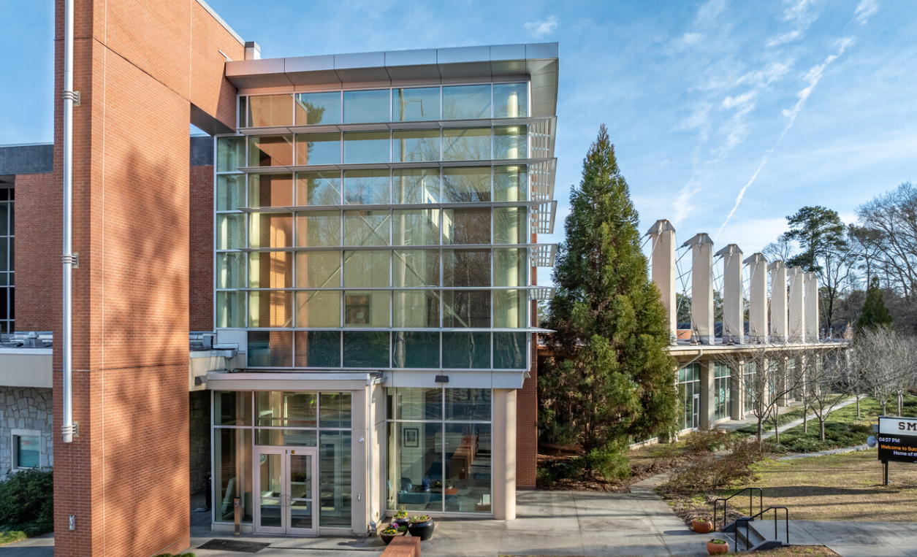
GO Team Meeting #1
Sutton Middle School
9/16/2025

Slide 2
Agenda

Slide 3
2021-2025
Strategic Plan

Slide 4
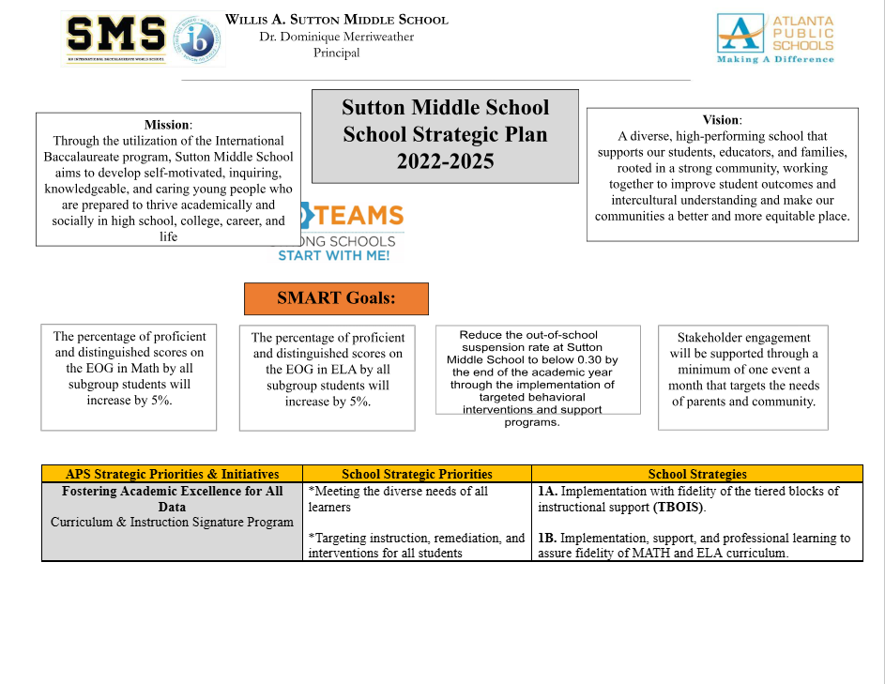
School Name
Mission
Vision
SMART Goals
TBD
TBD
TBD
APS Strategic Priorities & Initiatives
School Strategic Priorities
School Strategies
1A. tbd
1B. tbd
1C. tbd
Fostering Academic Excellence for All Data
Curriculum & Instruction Signature Program
Building a Culture of Student Support
Whole Child & Intervention Personalized Learning
TBD: tbd
TBD: tbd
4.
Equipping & Empowering Leaders & Staff
Strategic Staff Support Equitable Resource Allocation
6.
7.
Creating a System of School Support
Strategic Staff Support
Equitable Resource Allocation
8.
9.
14

Slide 5
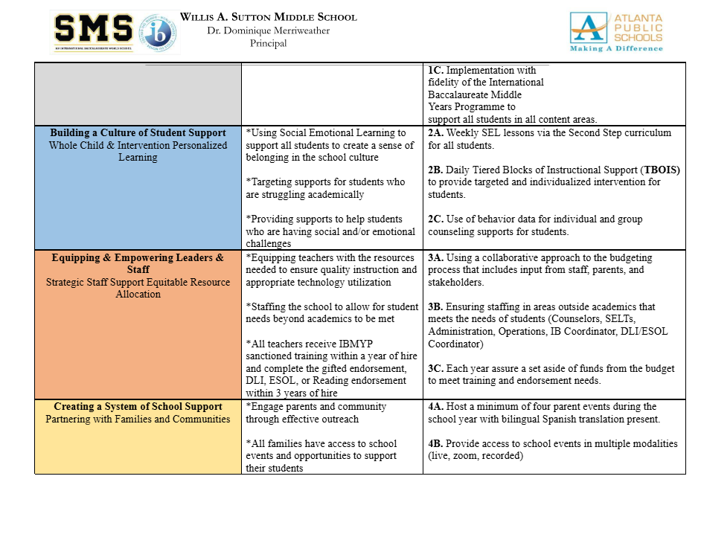

Slide 6
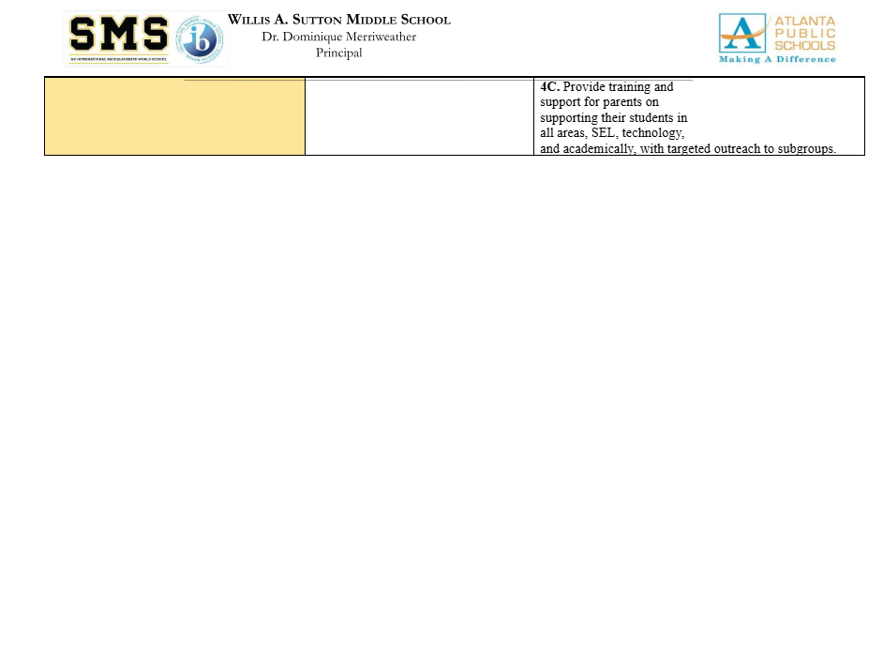

Slide 7
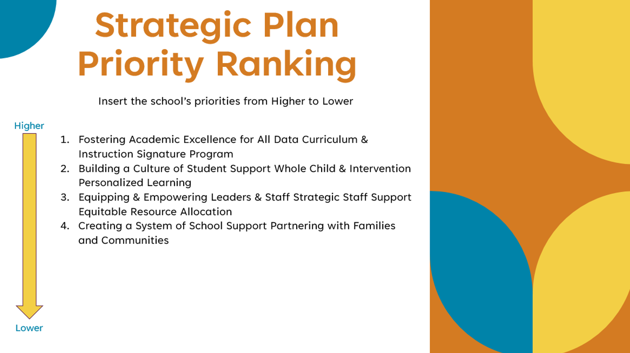
Strategic Plan
Priority Ranking
Insert the school’s priorities from Higher to Lower
Higher
Before Presenting to your GO Team:
Insert the Strategic Plan Ranking Slide from your last Fall 2024 Presentation
Lower

Slide 8
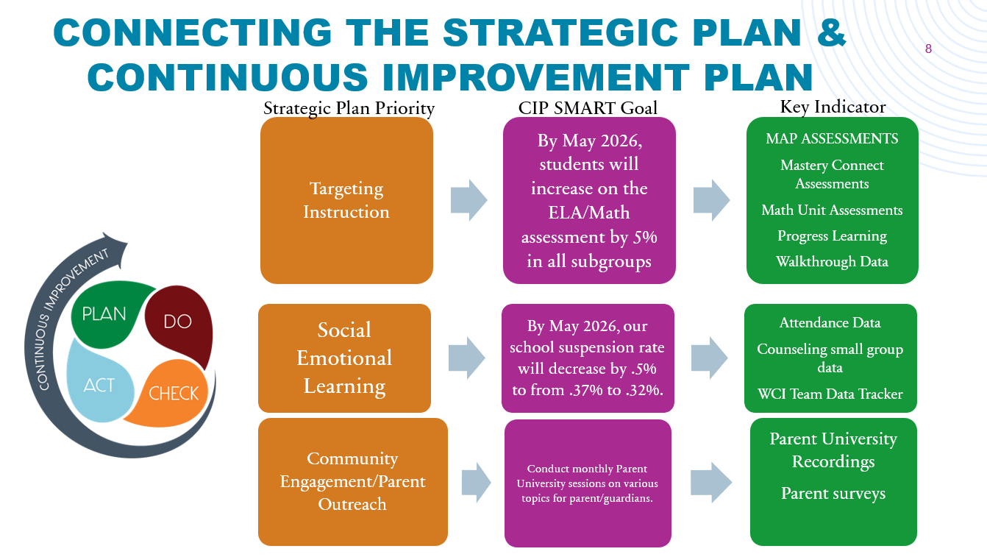
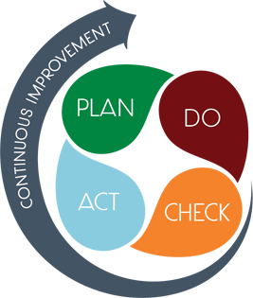
Connecting the Strategic plan &
Continuous Improvement Plan
Strategic Plan Priority
CIP SMART GOAL
KEY INDICATOR
Strategic Plan Priority
CIP SMART Goal
Key Indicator
Strategic Plan Priority
CIP SMART GOAL
KEY INDICATOR
Strategic Plan Priority
CIP SMART GOAL
KEY INDICATOR

Slide 9
Data
Discussion

Slide 10
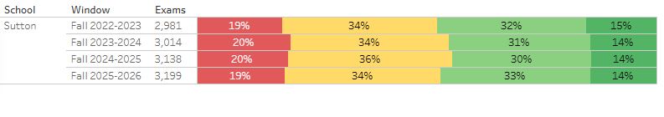
MAP Results

Slide 11
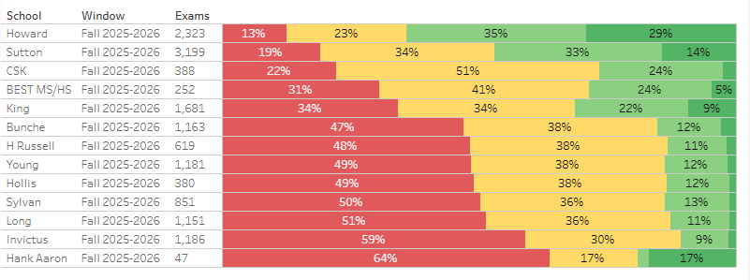

MAP Results by school

Slide 12
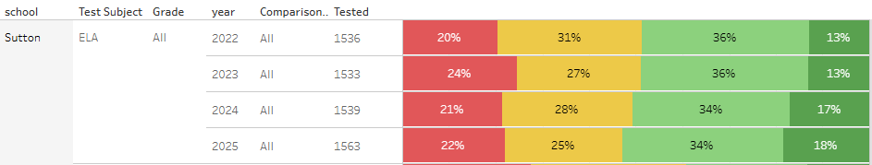
ELA GMAS Results

Slide 13
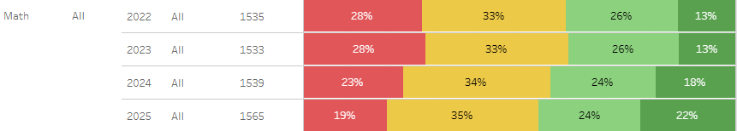
Math GMAS Results

Slide 14
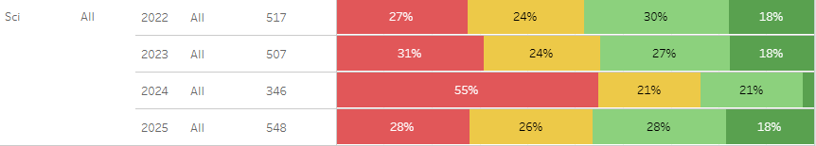
Science GMAS Results

Slide 15
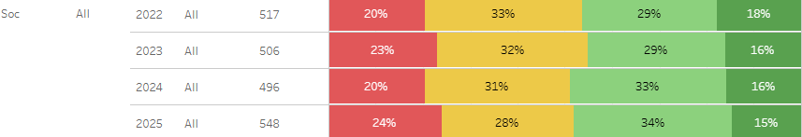
GMAS Results

Slide 16
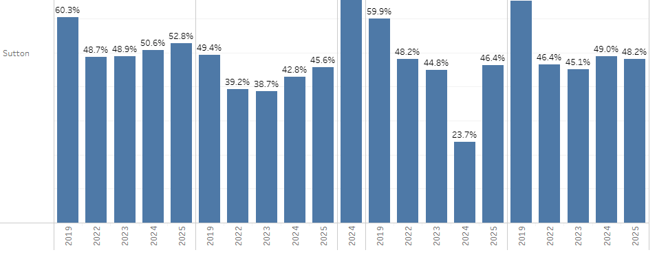


Year by Year GMAS Results

Slide 17
Glows & Grows
Glows
Grows
are we on target to successfully ACCOMPLISH our priorities?
IMPACT

Slide 18
GO Team Discussion:
Data Protocol
What do you notice?
What are your wonderings?
Based on our school’s trend data from MAP assessments and end-of-year test assessments, which student sub-groups and grade levels showed the most significant gaps or unexpected trends?
Based on our school’s trend data from MAP assessments, Milestones and other indicators, are there specific trends that require more focused attention?
What additional questions do you have?

Slide 19
Timeline for GO Teams
You are HERE
Fall 2021
GO Team Developed 2021-2025 Strategic Plan
1
Summer
School Leadership completed Needs Assessment and defined overarching needs
2
August
School Leadership completed Continuous Improvement Plan
3
Sept. – Dec.
GO Team reviews progress on current strategic plan.
GO Team develops 2025-2030 School Strategic Plan
4
Before Winter Break
GO Team will take action (vote) on the rank of the strategic plan priorities for SY26-27 in preparation for budget discussions.
5

Slide 20
Questions?

Slide 21
Principal’s Report

Slide 22



Sutton Middle School
LEVELING AND
FY26 BUDGET ADJUSTMENT
Template Last Revised: 9/4/2025

Slide 23

Enrollment
Projected Enrollment | 1638
15-Day Count(08.22.25) Enrollment | 1657
Difference | 19
Budget Adjustment* | $402,229
*The budget adjustment reflects the impact of the following: Enrollment changes, school reserves, Title I Part A, Title I- Family Engagement
Hold harmless
To support academic stability in schools, budgets were not reduced beyond school reserves.
Notes:
Principals: Based on your15-Day count, please give your GO Team an overview of your projected vs. 8/22 enrolled numbers as well as information on your FY26 budget adjustment.

Slide 24
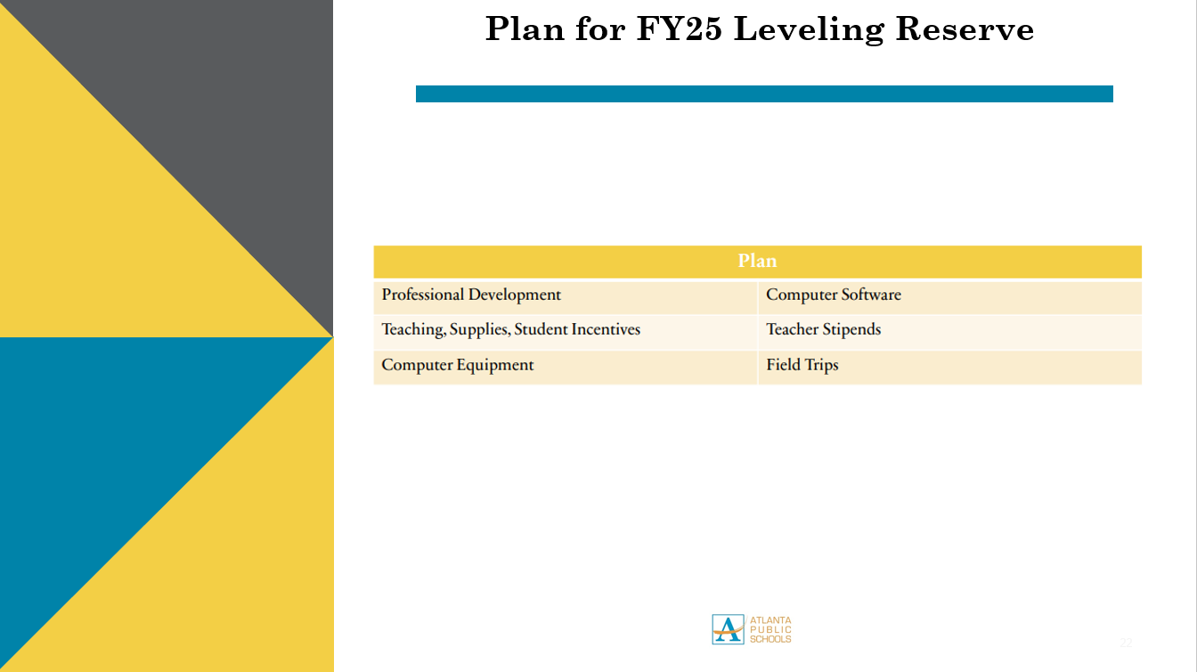
Plan for FY26 Leveling Reserve
$288,951
Notes:
Review the previously discussed plan for the FY26 Leveling Reserve as discussed by the GO Team in your Feb. 2025 Budget Feedback meeting and March 2025 Approval meeting.

Slide 25
Summary of Changes as a Result of FY26 Budget Adjustment
Personnel Changes | Non-Personnel Changes
None | None
Summary of Changes
PRINCIPALS: Please provide a summary of the impact these changes and how it relates to your strategic plan here.

Slide 26


APS Forward 2040:
Reshaping the Future of Education
Taskforce Meetings
May 8, 2025 - Presentation
August 5, 2025- Presentation
Upcoming Public Meetings
October 20
November 10
Virtual – at Noon
In-person at 6PM at CLL (130 Trinity Ave)
UPDATE
Comprehensive Long-Range Facilities Plan
atlantapublicschools.us/APS2040
Notes:
Next on our agenda, we’d like to welcome our representative to the Long-Range Comprehensive Facilities Master Plan Taskforce. As many of you know, this taskforce plays a key role in shaping the future of our district’s facilities — ensuring they are aligned with projected enrollment, instructional needs, safety standards, and long-term community use."
Over the summer, the taskforce has been hard at work reviewing data, exploring options, and engaging in important planning conversations. [Name of Representative] will share an update on what’s been done so far, any key decisions or recommendations that have been made, and what’s ahead — including opportunities for the public to provide input.
[Allow the FMP representative to provide an update and answers questions. After this is concluded:]
Thank you [Name of Representative].
A report will be presented to the Board at its August 11 meeting, and the options will become public the week of August 18.
There are several upcoming public meetings where you can learn more and share your thoughts. The next public meetings are scheduled for: August 25, October 20, and November 10
On each date, there will be a virtual meeting at noon and an in-person meeting at the Central Office at 6PM.
I strongly encourage you all to attend these meetings. This is a critical time for public input, and your voice is essential.

Slide 27
SAVE THE DATE
IN-PERSON
G3 Summit
Go.Grow.Govern.
Bring the full GO Team
Come ready to collaborate, contribute, and create the future!
Saturday
September 27
8:30 AM – 2:30 PM
Come learn more about:
Your school’s 2025-2030 Strategic Plan
Stakeholder Engagement
Charter System
…and much more
Atlanta College & Career Academy
1090 Windsor St SW
Notes:
Before we move on, I want to highlight an important upcoming event: the G3 Summit on Saturday, September 27 at the Atlanta College and Career Academy.
We need as many GO Team members as possible to attend — this is a critical opportunity to come together, in person, and shape the future of our schools. Strategic planning for 2025–2030 is underway, and your voices, ideas, and leadership are essential.
You’ll be learning about your school’s new strategic plan, best practices for stakeholder engagement, and how this work connects to APS Forward 2040 — plus much more.
Please save the date and plan to attend! Come ready to collaborate, contribute, and create the future together.
More information will be coming soon.

Slide 28
Questions?

